Slide 1

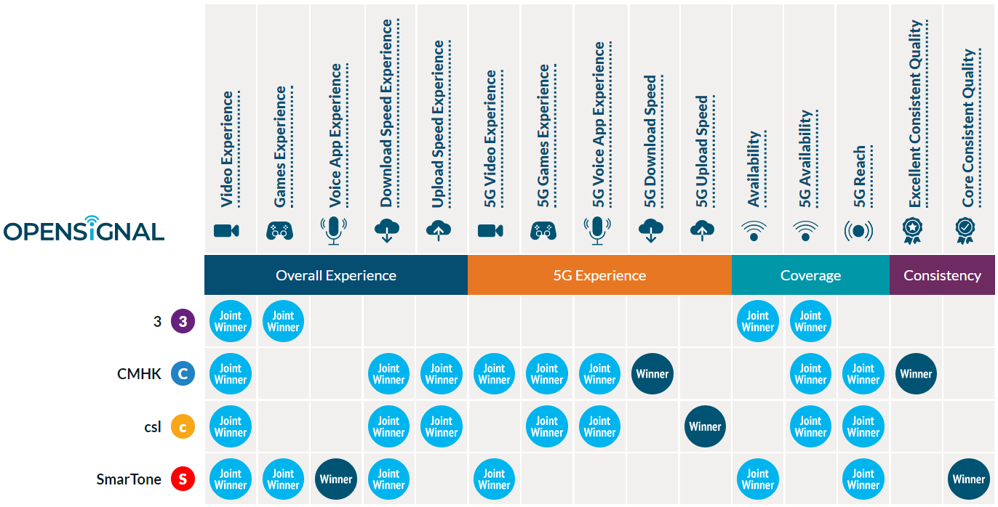
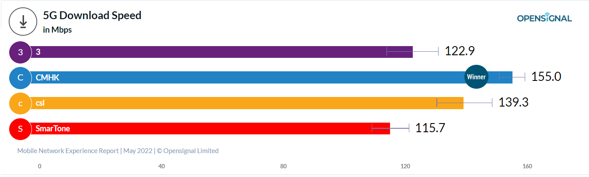
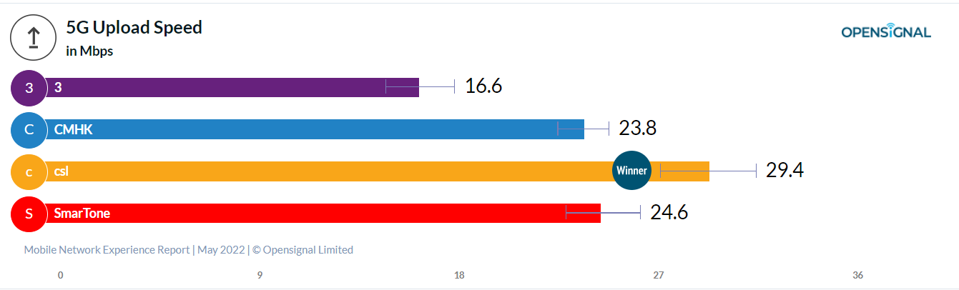
5G Experience and the overall mobile experience of all Hong Kong users
Hong Kong Mobile Network Experience Report
Having a strong mobile network experience is important for an operator to retain and acquire customers. In this report we see areas of success for each of Hong Kong's mobile operators across mobile gaming, video streaming, voice communications, speed and consistency. Smartphone users will differ in which area appeals to them most.

